Slide 1
IPSOMEDT Marine Tool
ROLLS-ROYCE ELECTRICAL, SINGAPORE
Presenters: Wang Zihao

Slide 2
Discussion Overview
Overall design of IPSOMEDT Marine
High level architecture
Potential issues

Slide 3
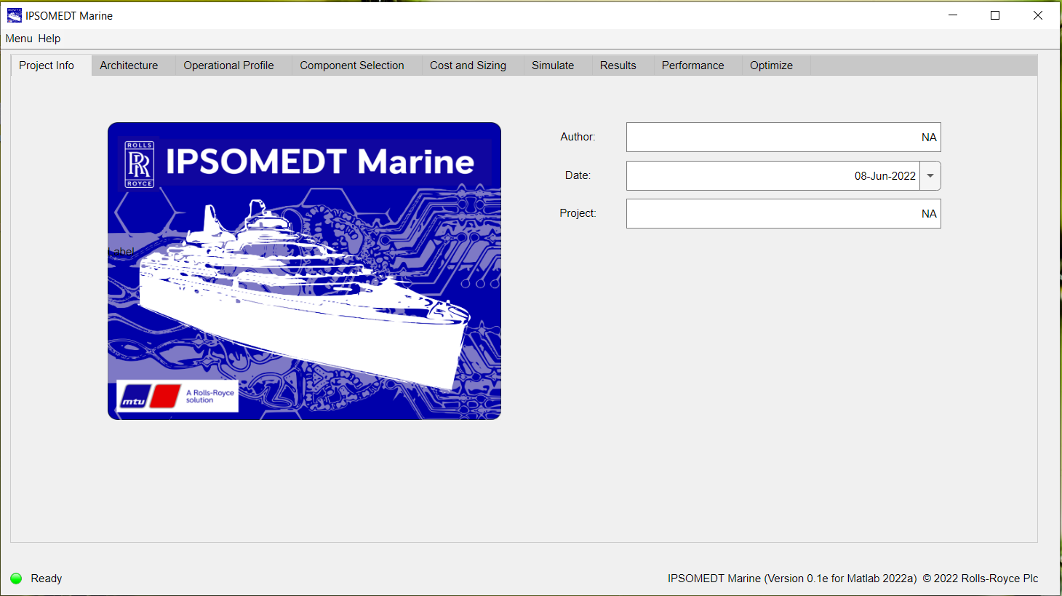
Overall Design

Slide 4
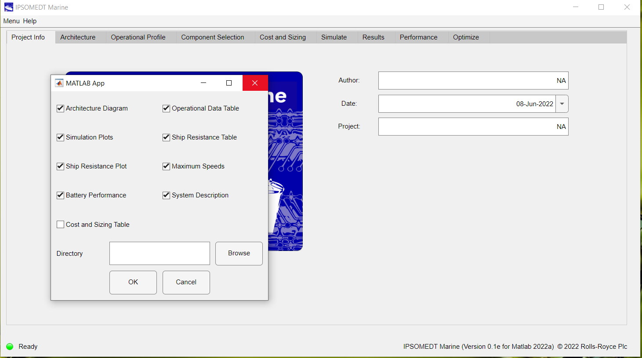
Overall Design

Slide 5
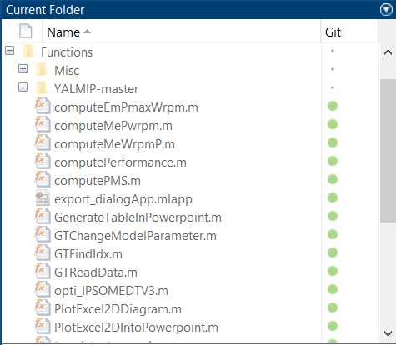
Functions for data computation
High-level Architecture

Slide 6
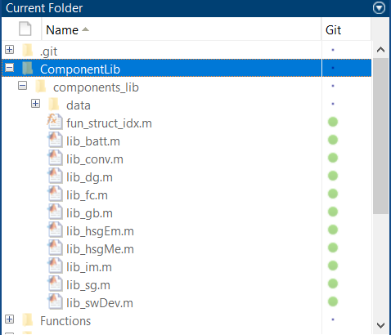
User-defined libraries
High-level Architecture

Slide 7
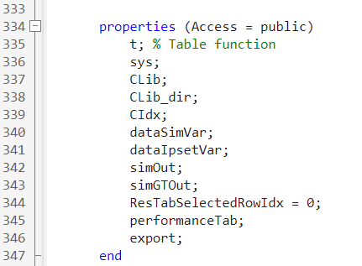
Properties
High-level Architecture

Slide 8
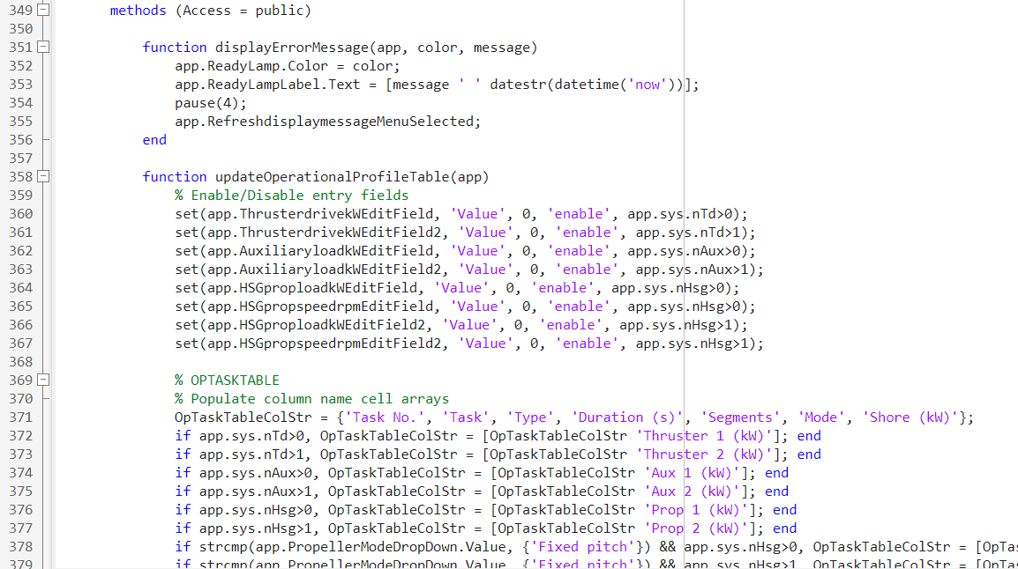
User-defined functions
High-level Architecture

Slide 9
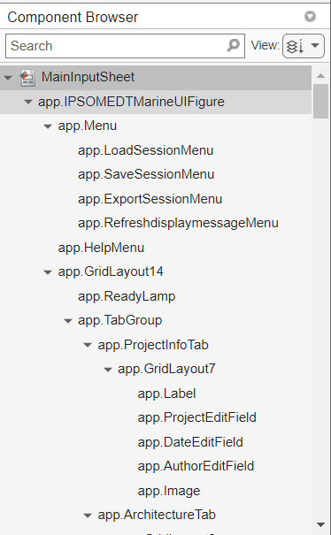
Callbacks
High-level Architecture

Slide 10
Summary
Refactors user-defined utility functions to another file
Refactors user-defined libraries to another file
Uses properties and structures to organize variables
Callbacks
Decreases memory usage by reducing the number of temporary variables
Vectorization

Slide 11
Potential Issues
For developer side:
Loading the mlapp file is slow (i.e., loading the existing files and codes)
The editor is slow and delayed
Compiling and running the mlapp file is slow after clicking the ‘save’ and ‘run’ buttons
For now, the lagging is still tolerable. But when the mlapp file becomes larger, we foresee the delay will be substantial
Any advices regarding the coding style and code organization that
will potentially speed up the app designer?

